Slide 1
PHC 6194-spatial epidemiology Coordinate systems and Map Project Xiaohui Xu, Ph.D Department of Epidemiology

Slide 2
Acknowledgement
This lecture is modified based on Dr. YouLiang Qiu’ lecture slides from the UF Department of Geography.

Slide 3
Coordinate systems
Why do we need coordinate systems for spatial data?
What is it?

Slide 4
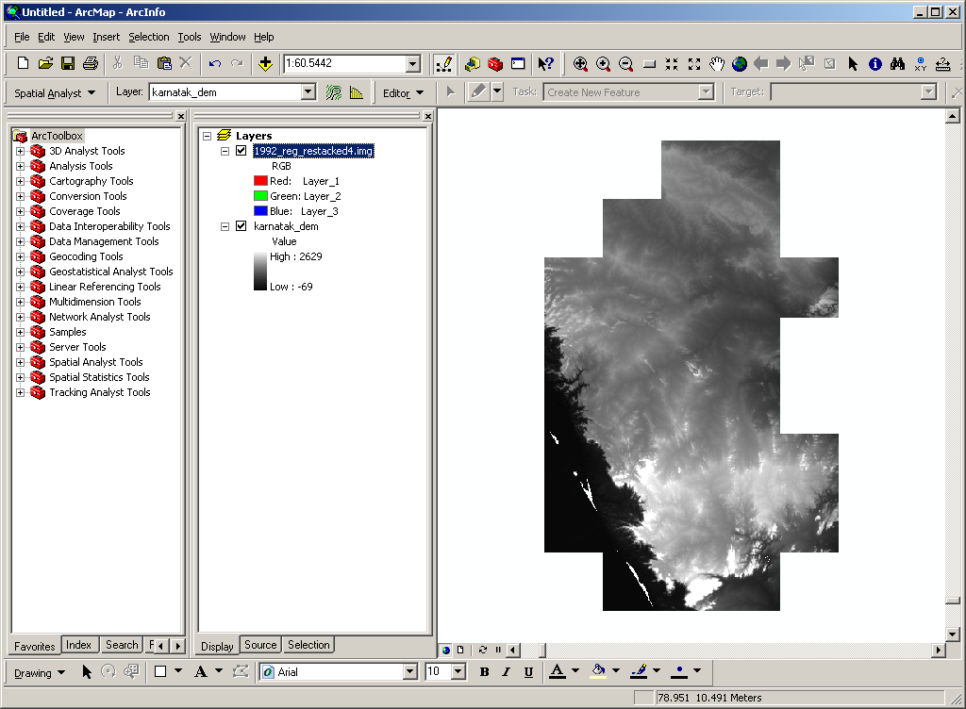
What is wrong in this map?

Slide 5
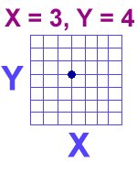
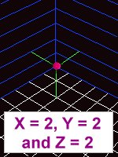


Coordinate, is it simple?
2D flat map
3D sphere

Slide 6
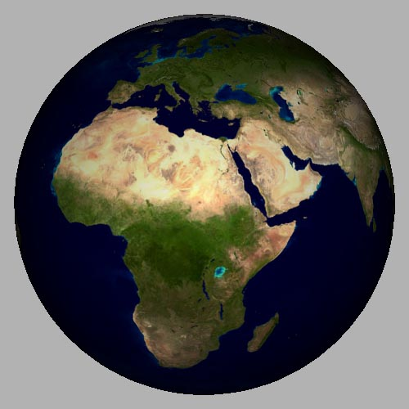
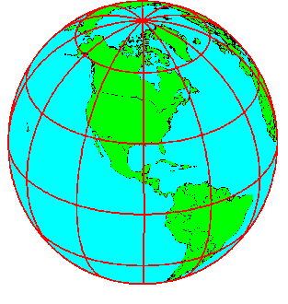
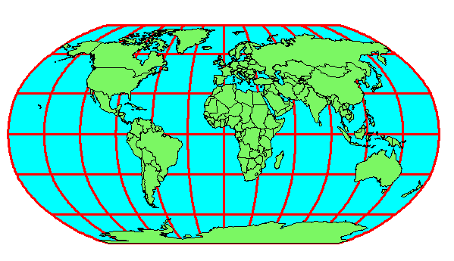
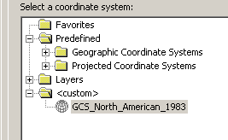
Two Types of Coordinate System
3D sphere
Geographic Coordinate System
2D flat, Projected Coordinate System

Slide 7
Coordinate system
Geographic coordinate systems
A geographic coordinate system (GCS) uses a three-dimensional spherical surface to define locations on the earth.

Slide 8
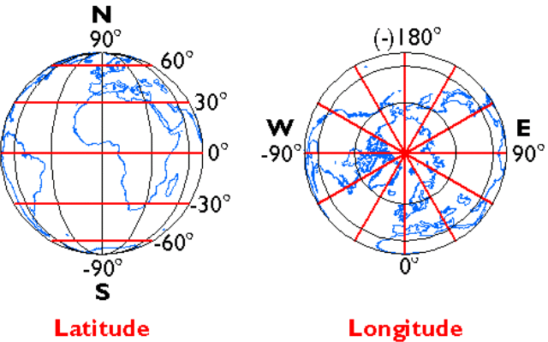
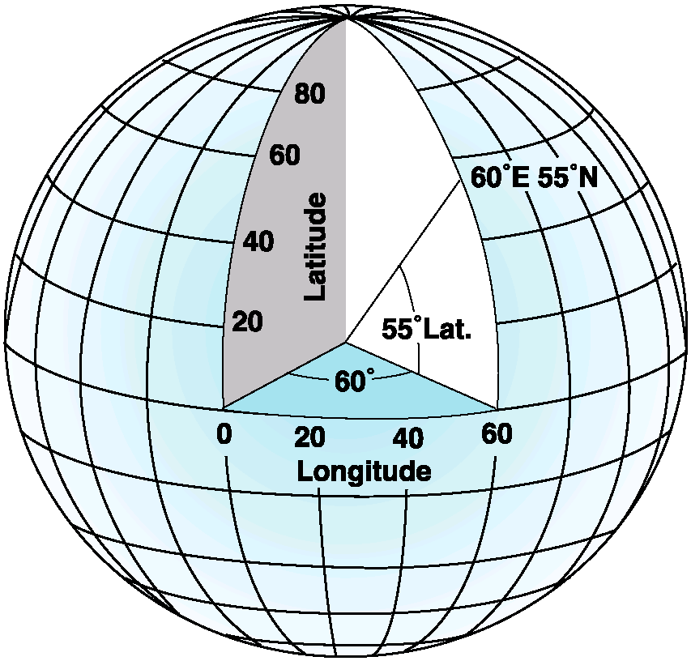
Spherical Coordinate System: Graticule
Graticule of meridians and parallels
Longitude and latitude
Units: Degrees (DMS or DD)
Where are the great circles and the small circles?
Notes:
Equator: The line of latitude midway between the poles

Slide 9
Working with Degrees
DMS (degree, minute, second) DD (decimal degree)
1°= 60’
1’ = 60”
1° = 60’ x 60” = 3600”
DMS: 51° 29' 16" ⬅➔ DD: 51.4877
29 minutes = 29/60 = 0.4833 degrees 16 seconds = 16/3600 = 0.0044 degrees
51° + 0.4833 ° + 0.0044 ° = 51.4877 °
23.2256 = 23° ? ' ? "
0.2256° * 60 = 13.536' ➔ 0.536' * 60 = 32.16”
23.2256° = 22° 13 ' 32.16 "

Slide 10
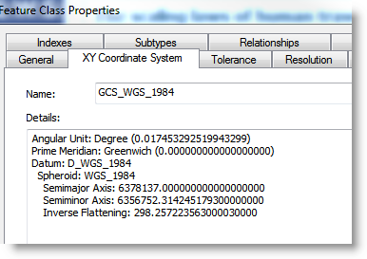
What is WGS_1984?
We need to know the things behind the name

Slide 11
A few terms
Geoid
Ellipsoid and spheroid
Datum

Slide 12
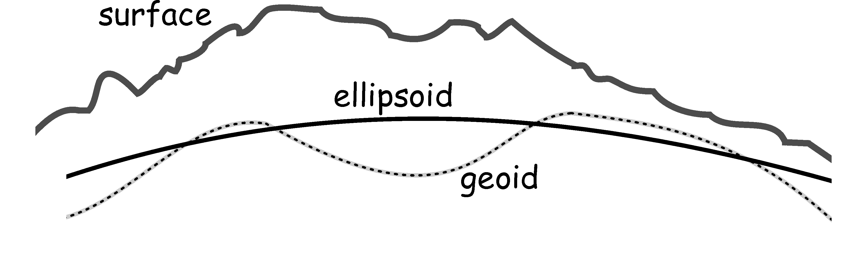
The Shape of the Earth

Slide 13
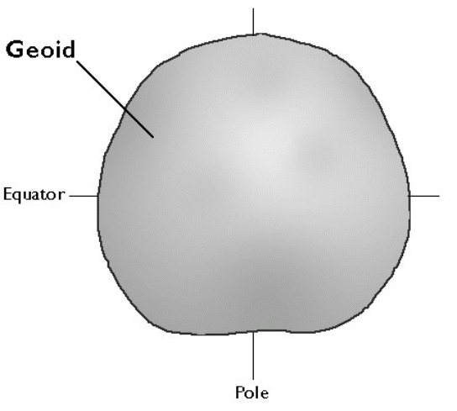
The Geoid
Another model of the earth’s surface
3-D surface defined by empirical (measured) data that describes the constant gravitational potential, rather than mathematically. (i.e. the surface of the earth's gravity field)
Coincides well with mean sea level for entire planet
Reference surface for vertical position (elevation or height)
Used in conjunction with the ellipsoid to define vertical datum

Slide 14
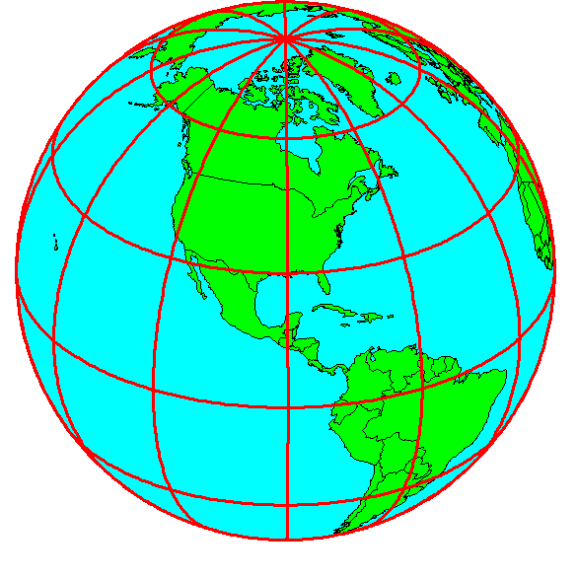
Spheroid/Ellipsoid
It is actually a spheroid, slightly larger in radius at the equator than at the poles
We think of the
earth as a sphere
Equatorial circumference = 40,705 km
Polar circumference = 40,008 km
Notes:
Ellipse

Slide 15
Define an Ellipsoid
A mathematical model of the earth must be selected.
Z
Rotational axis
b
b
O
a
O
a
Y
X
a
F₁
ε
ε
F2
X
P
For the earth:
Major axis, a = 6378 km
Minor axis, b = 6357 km
Flattening ratio, f = (a-b)/a ~ 1/300
Notes:
More correctly, the Earth is an ellipsoid, a special or specific case of spheroid: the oblate spheroid class

Slide 16
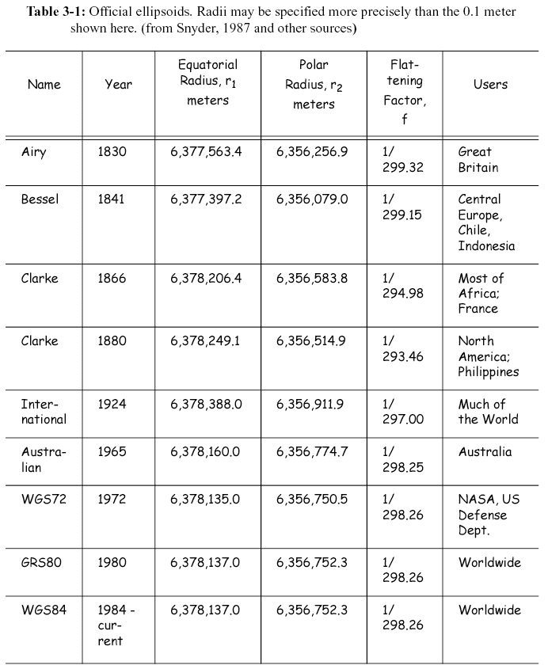
Official Ellipsoids
Many others too!
Why more than one?
Notes:
Why more than one?
Notice the Year column
What do you think measurement technology might have been like?
Think about geographic extent
Many others too…

Slide 17
Summary
Surface = The Earth’s real surface, all the mountains, depressions, etc.
Geoid = Bumpy surface. Surface of constant gravitational potential (which varies locally) empirically defined by a system of data where gravity is equal for all locations. Measurement equipment: Gravimeter.
Ellipsoid = Ideal, smooth surface, mathematically defined by the semi-major and semi-minor axes.

Slide 18
Datums
A datum defines the position of the spheroid relative to the center of the earth.

Slide 19
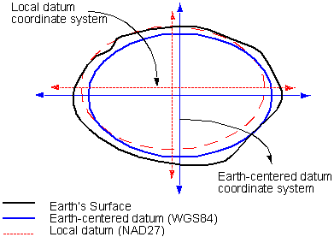
Global vs. Local Datum
1. Ellipsoid with a spherical coordinate system and an origin

Slide 20
Global vs. Local Datum
Global datum
Datum uses the earth's center of mass as the origin
Local datum
A local datum aligns its spheroid to closely fit the earth's surface in a particular area.
A point on the surface of the spheroid is matched to a particular position on the surface of the earth. (The origin point of the datum)
The coordinate system origin of a local datum is not at the center of the earth.

Slide 21
Common Global vs. Local Datum
Common Local Datum
North American Datum (NAD)
Australian Geodetic Datum (AGD)
European Geodetic Datum (EGD),
Tokyo Datum (TD)
Common Global Datum
World Geodetic System (WGS)

Slide 22
Principal Datums Used in USA
North American Datum of 1927 (NAD27)
North American Datum of 1983 (NAD83)
World Geodetic System of 1984 (WGS84)

Slide 23
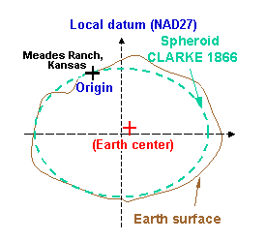
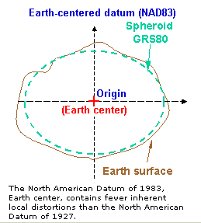
NAD 27 and NAD 83
North American Datum - 1927
North American Datum - 1983
250,000 survey stations
And 2,000,000 distance measurements
26,000 survey stations

Slide 24
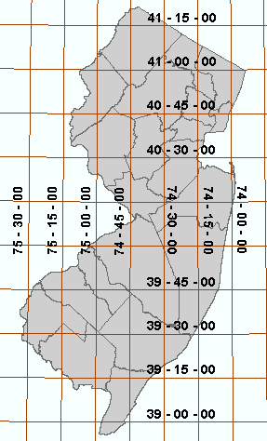
WGS84
World Geodetic System - 1984
The datum on which GPS coordinates are based and probably the most common datum for GIS data sets with global extent. Devolped by DoD.

Slide 25
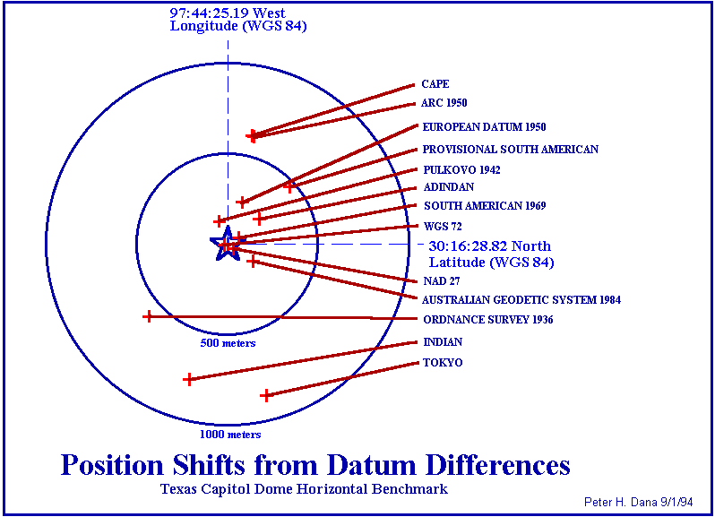
Position Shifts and Datums
Incorrect datum ⇨ a mismatch of the positions of mapped features.
Errors approaching one kilometer (this is a worst-case scenario, and unlikely).
As long as the two datums in question are known, conversion is possible in GIS.

Slide 26
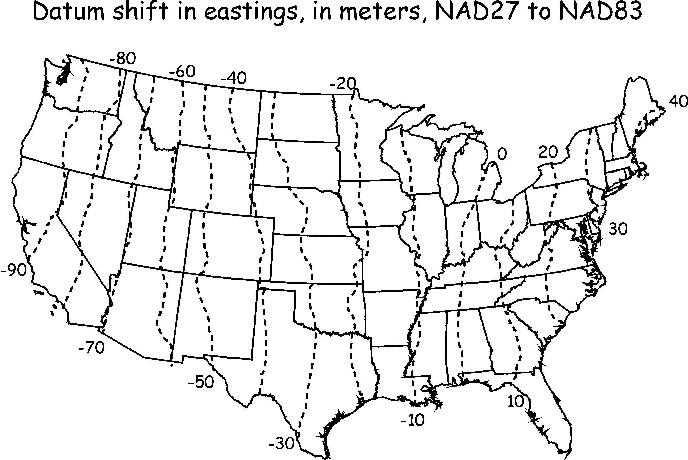
East-West Datum Shift with NAD27 and NAD83

Slide 27
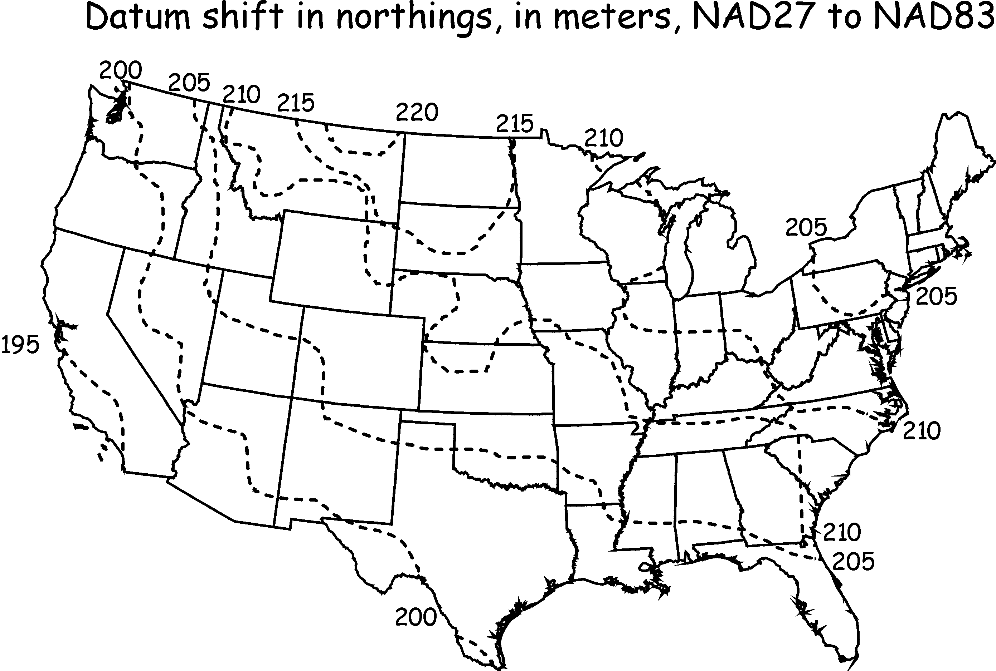
North-South Datum Shift with NAD27 and NAD83

Slide 28
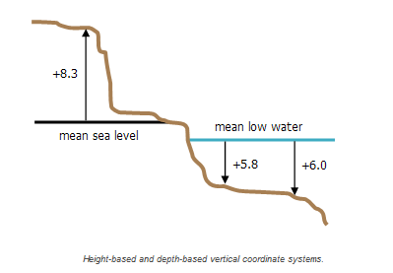
Horizontal vs Vertical Datums
Horizontal datums are the reference values for a system of location measurements.
Vertical datums are the reference values for a system of elevation measurements.
The job of a vertical datum is to define where zero elevation is, this is usually done by determining mean sea level, a project that involves measuring tides over a cycle of many years.

Slide 29
Vertical Datums
A “zero surface” from which all elevations or heights (e.g. of mountain peaks) are measured.
Usually the mean sea level (MSL) is used as the vertical datum globally
Local vertical datums are defined for use in specific geographic areas and rely on locally determined MSL readings, aka. shoreline height
Common vertical datums for the USA are National Geodetic Vertical Datum of 1929 (NGVD29) and North American Vertical Datum of 1988 (NAVD88)

Slide 30
Projected Coordinate Systems

Slide 31
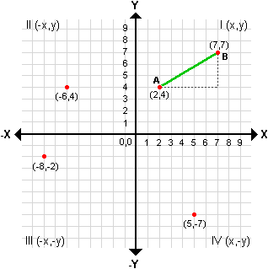
Flattening the Earth:
You will often use a Cartesian coordinate system (squared grid)
How do you go from the round Earth to a flattened map and coordinate system?
We need Projected coordinate system

Slide 32
What are projected coordinate systems?
A projected coordinate system is defined on a flat, two-dimensional surface.
Unlike a geographic coordinate system, a projected coordinate system has constant lengths, angles, and areas across the two dimensions.
A projected coordinate system is always based on a geographic coordinate system

Slide 33
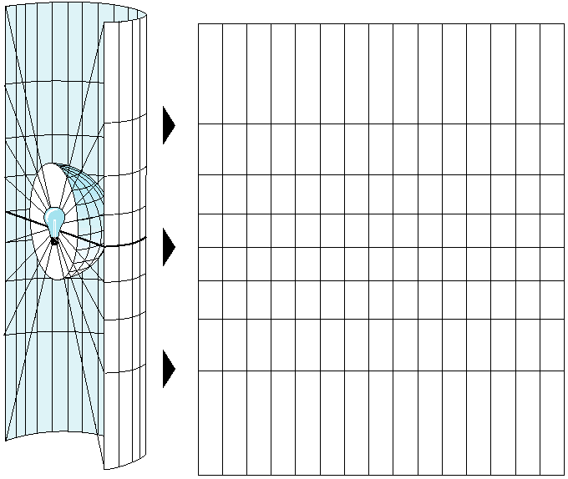
Map Projection
The systematic rendering of a graticule on a flat map surface
Why? Because globes are difficult to digitize…carry in your pocket…measure the distance from here to JAX, etc.
Easier to read a flat map
Perspective does not influence the view of the information
Real-world features must be projected with minimum distortion from a round earth to a flat map; and given a grid system of coordinates.

Slide 34
Specifications for Map Projections
Location of light source
Ellipsoid center → Gnomonic projection
Antipode → Stereographic projection
Infinity (off of ellipsoid) → Orthographic projection
Projection Surfaces
Planar
Cylindrical
Conic
Location of the projection surface
Tangential vs. Intersecting aka Secant
Orientation of the projection surface relative to the equator and poles

Slide 35
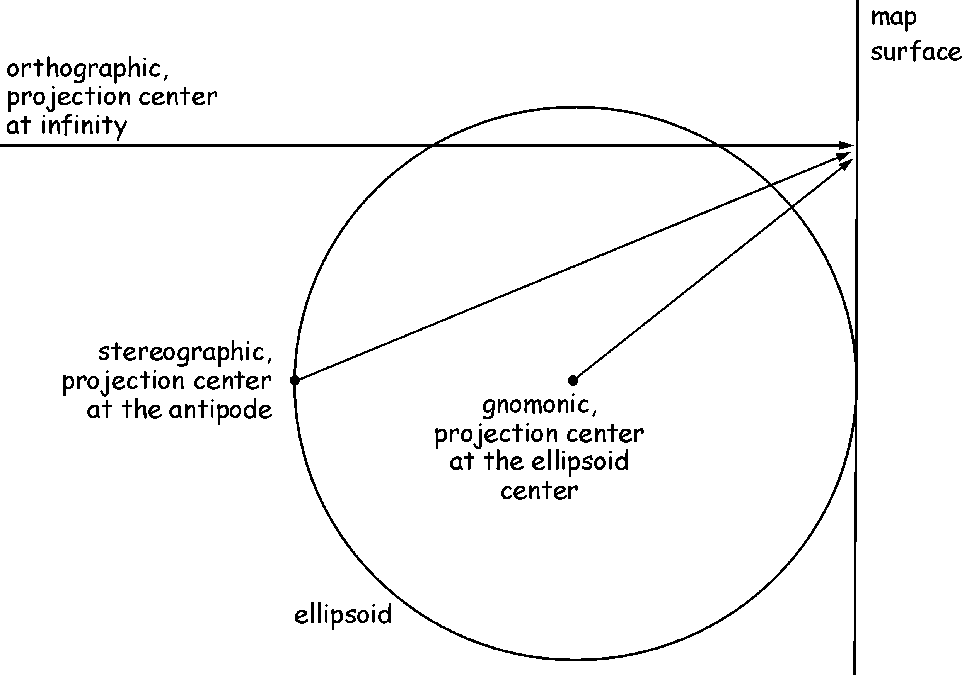
Projection Light Source
The position affects the resulting map.
Gnomonic: globe center (light source 1)
Stereographic: on globe surface, opposite the projection surface (light source 2)
Orthographic: off globe surface at distance infinity (light source 3)

Slide 36
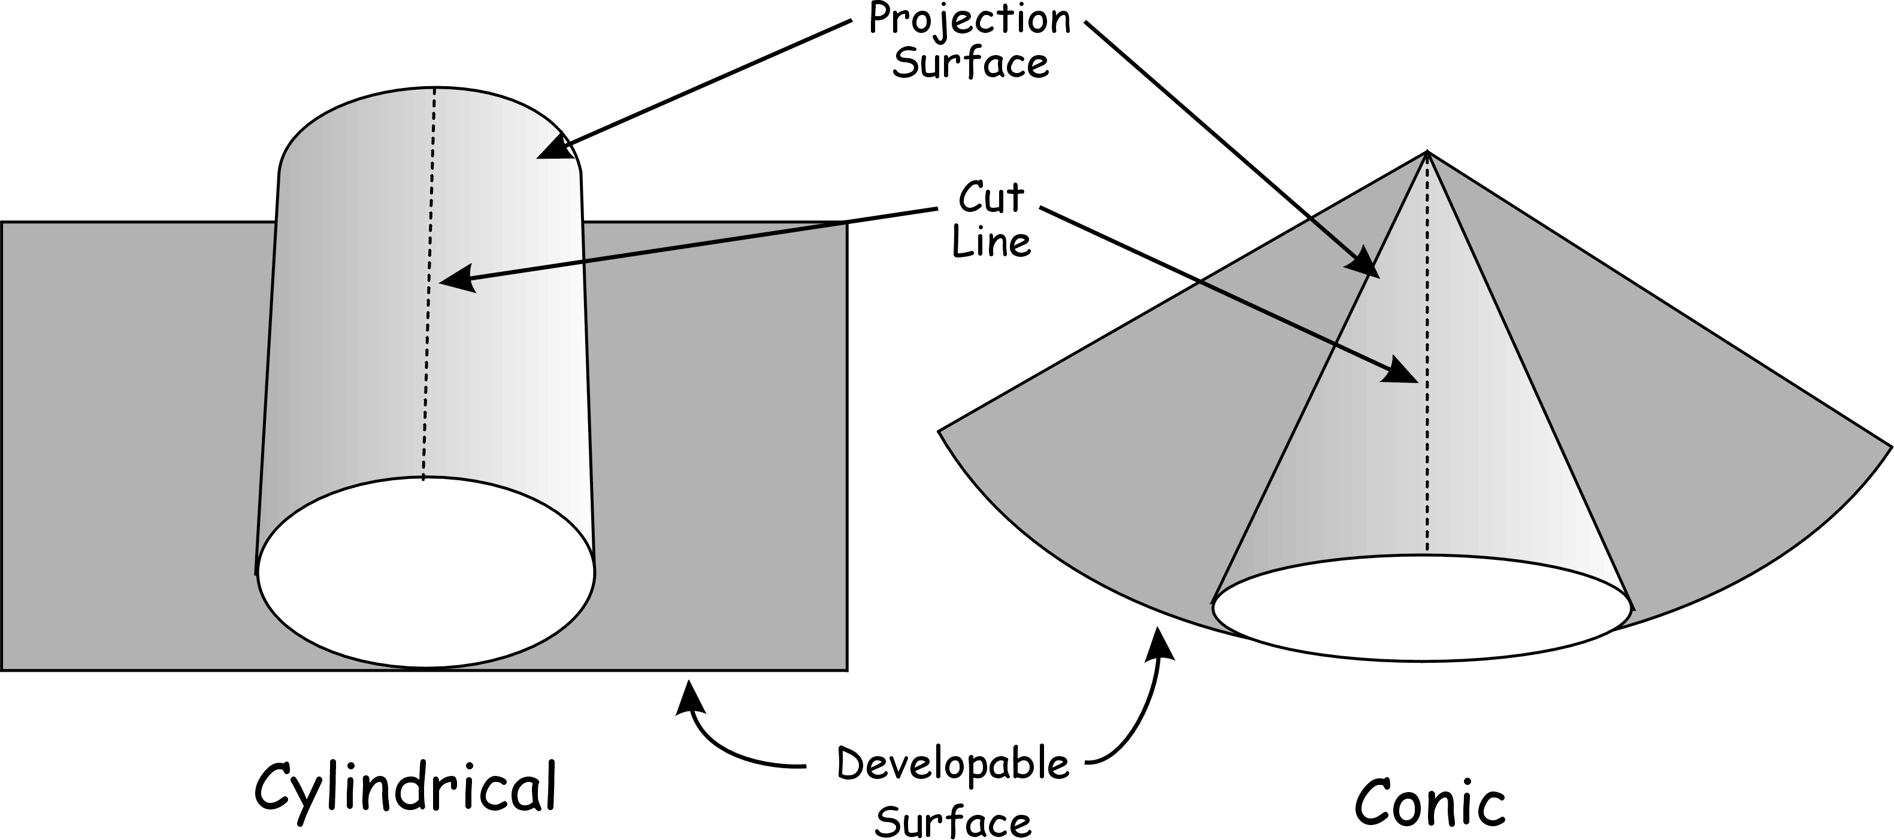
Projection Surfaces
The “physical” surface used to construct a map
Plane – starts flat, stays flat
Developable surface – starts “rolled”, ends flat

Slide 37
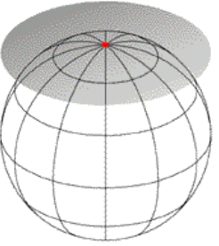
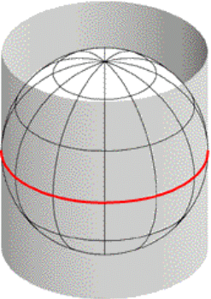
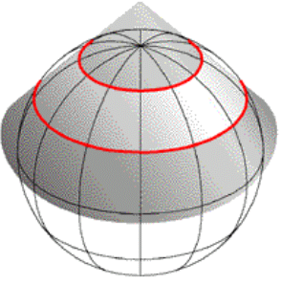
Three Common Projection Surfaces
Plane
(Planar or Azimuthal)
Cone
(Conic)
Cylinder
(Cylindrical)
tangent
secant
tangent
tangent – being in contact at a single point or along a line
secant – cutting, intersecting
(The red indicates contact between the sphere and the projection surface.)

Slide 38
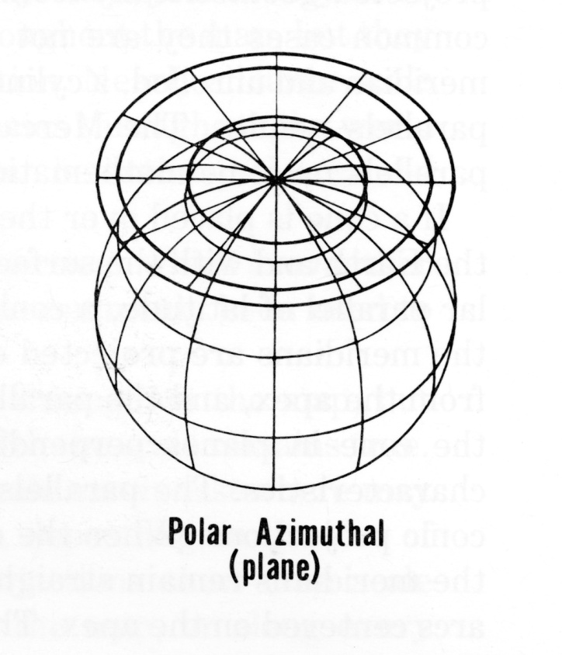
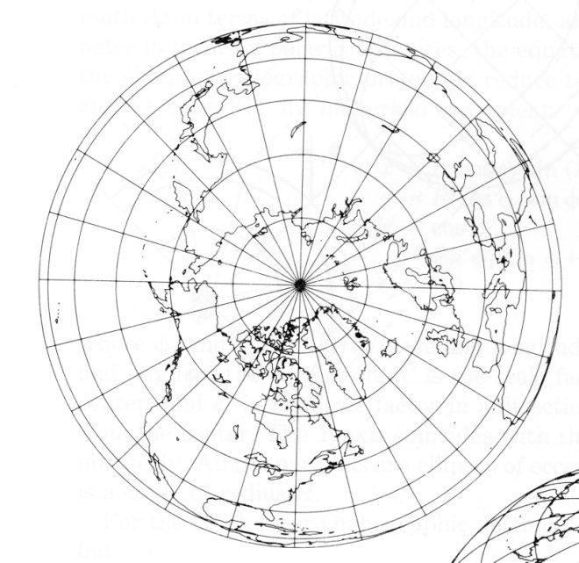
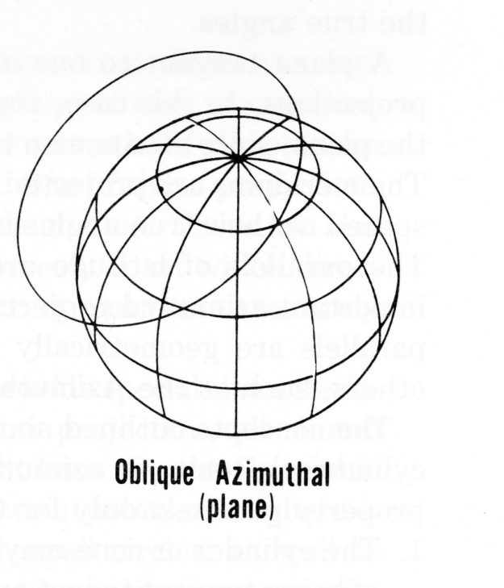
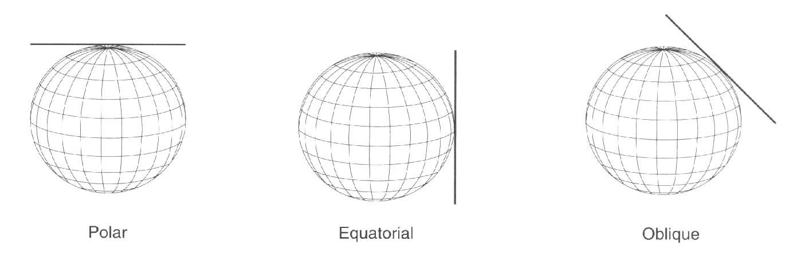
Planar and Azimuthal Projections

Slide 39
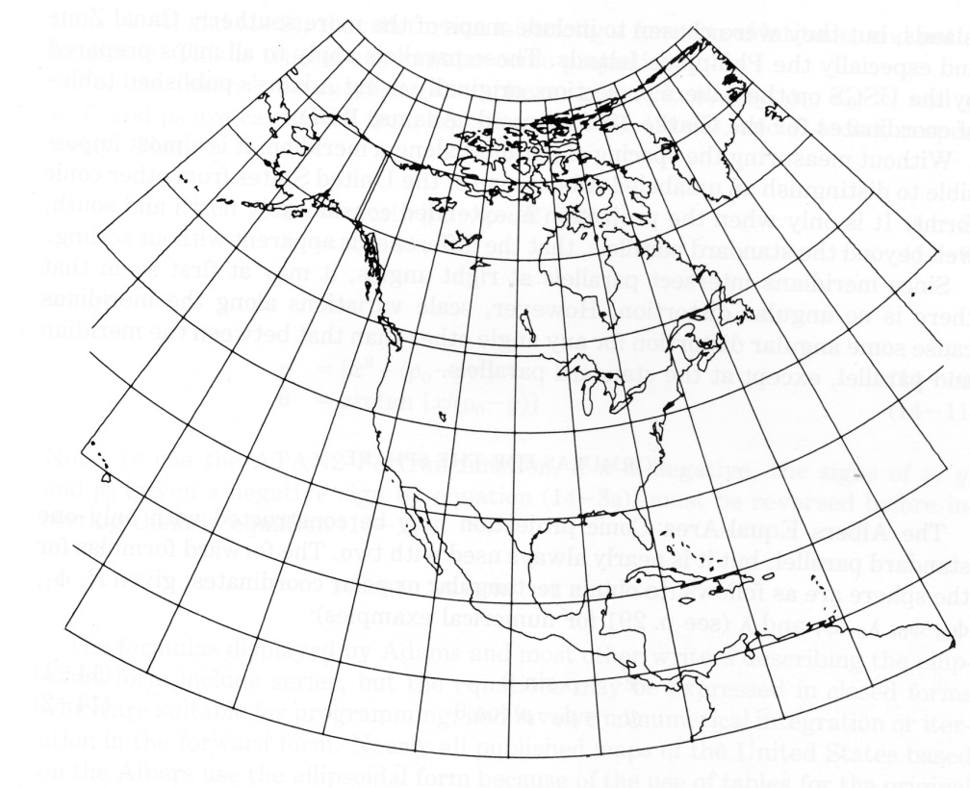
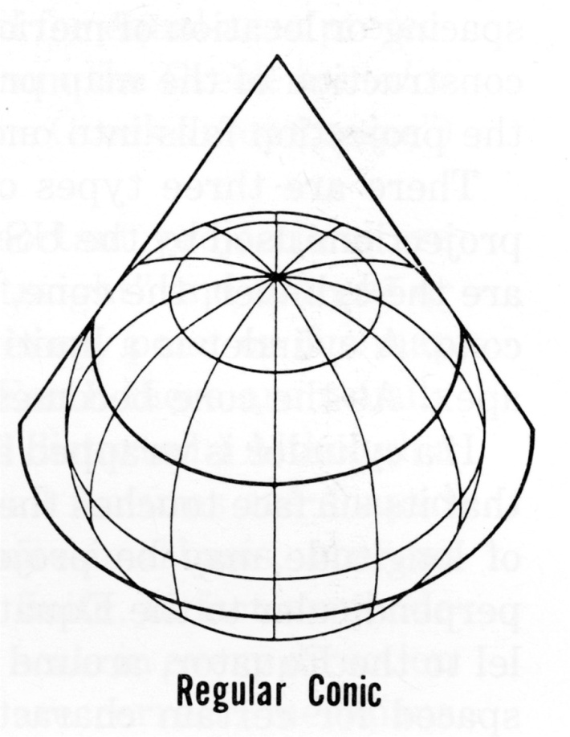
Conic Projections
(North up)

Slide 40
Cylindrical Projections
Regular
Oblique
Transverse

Slide 41
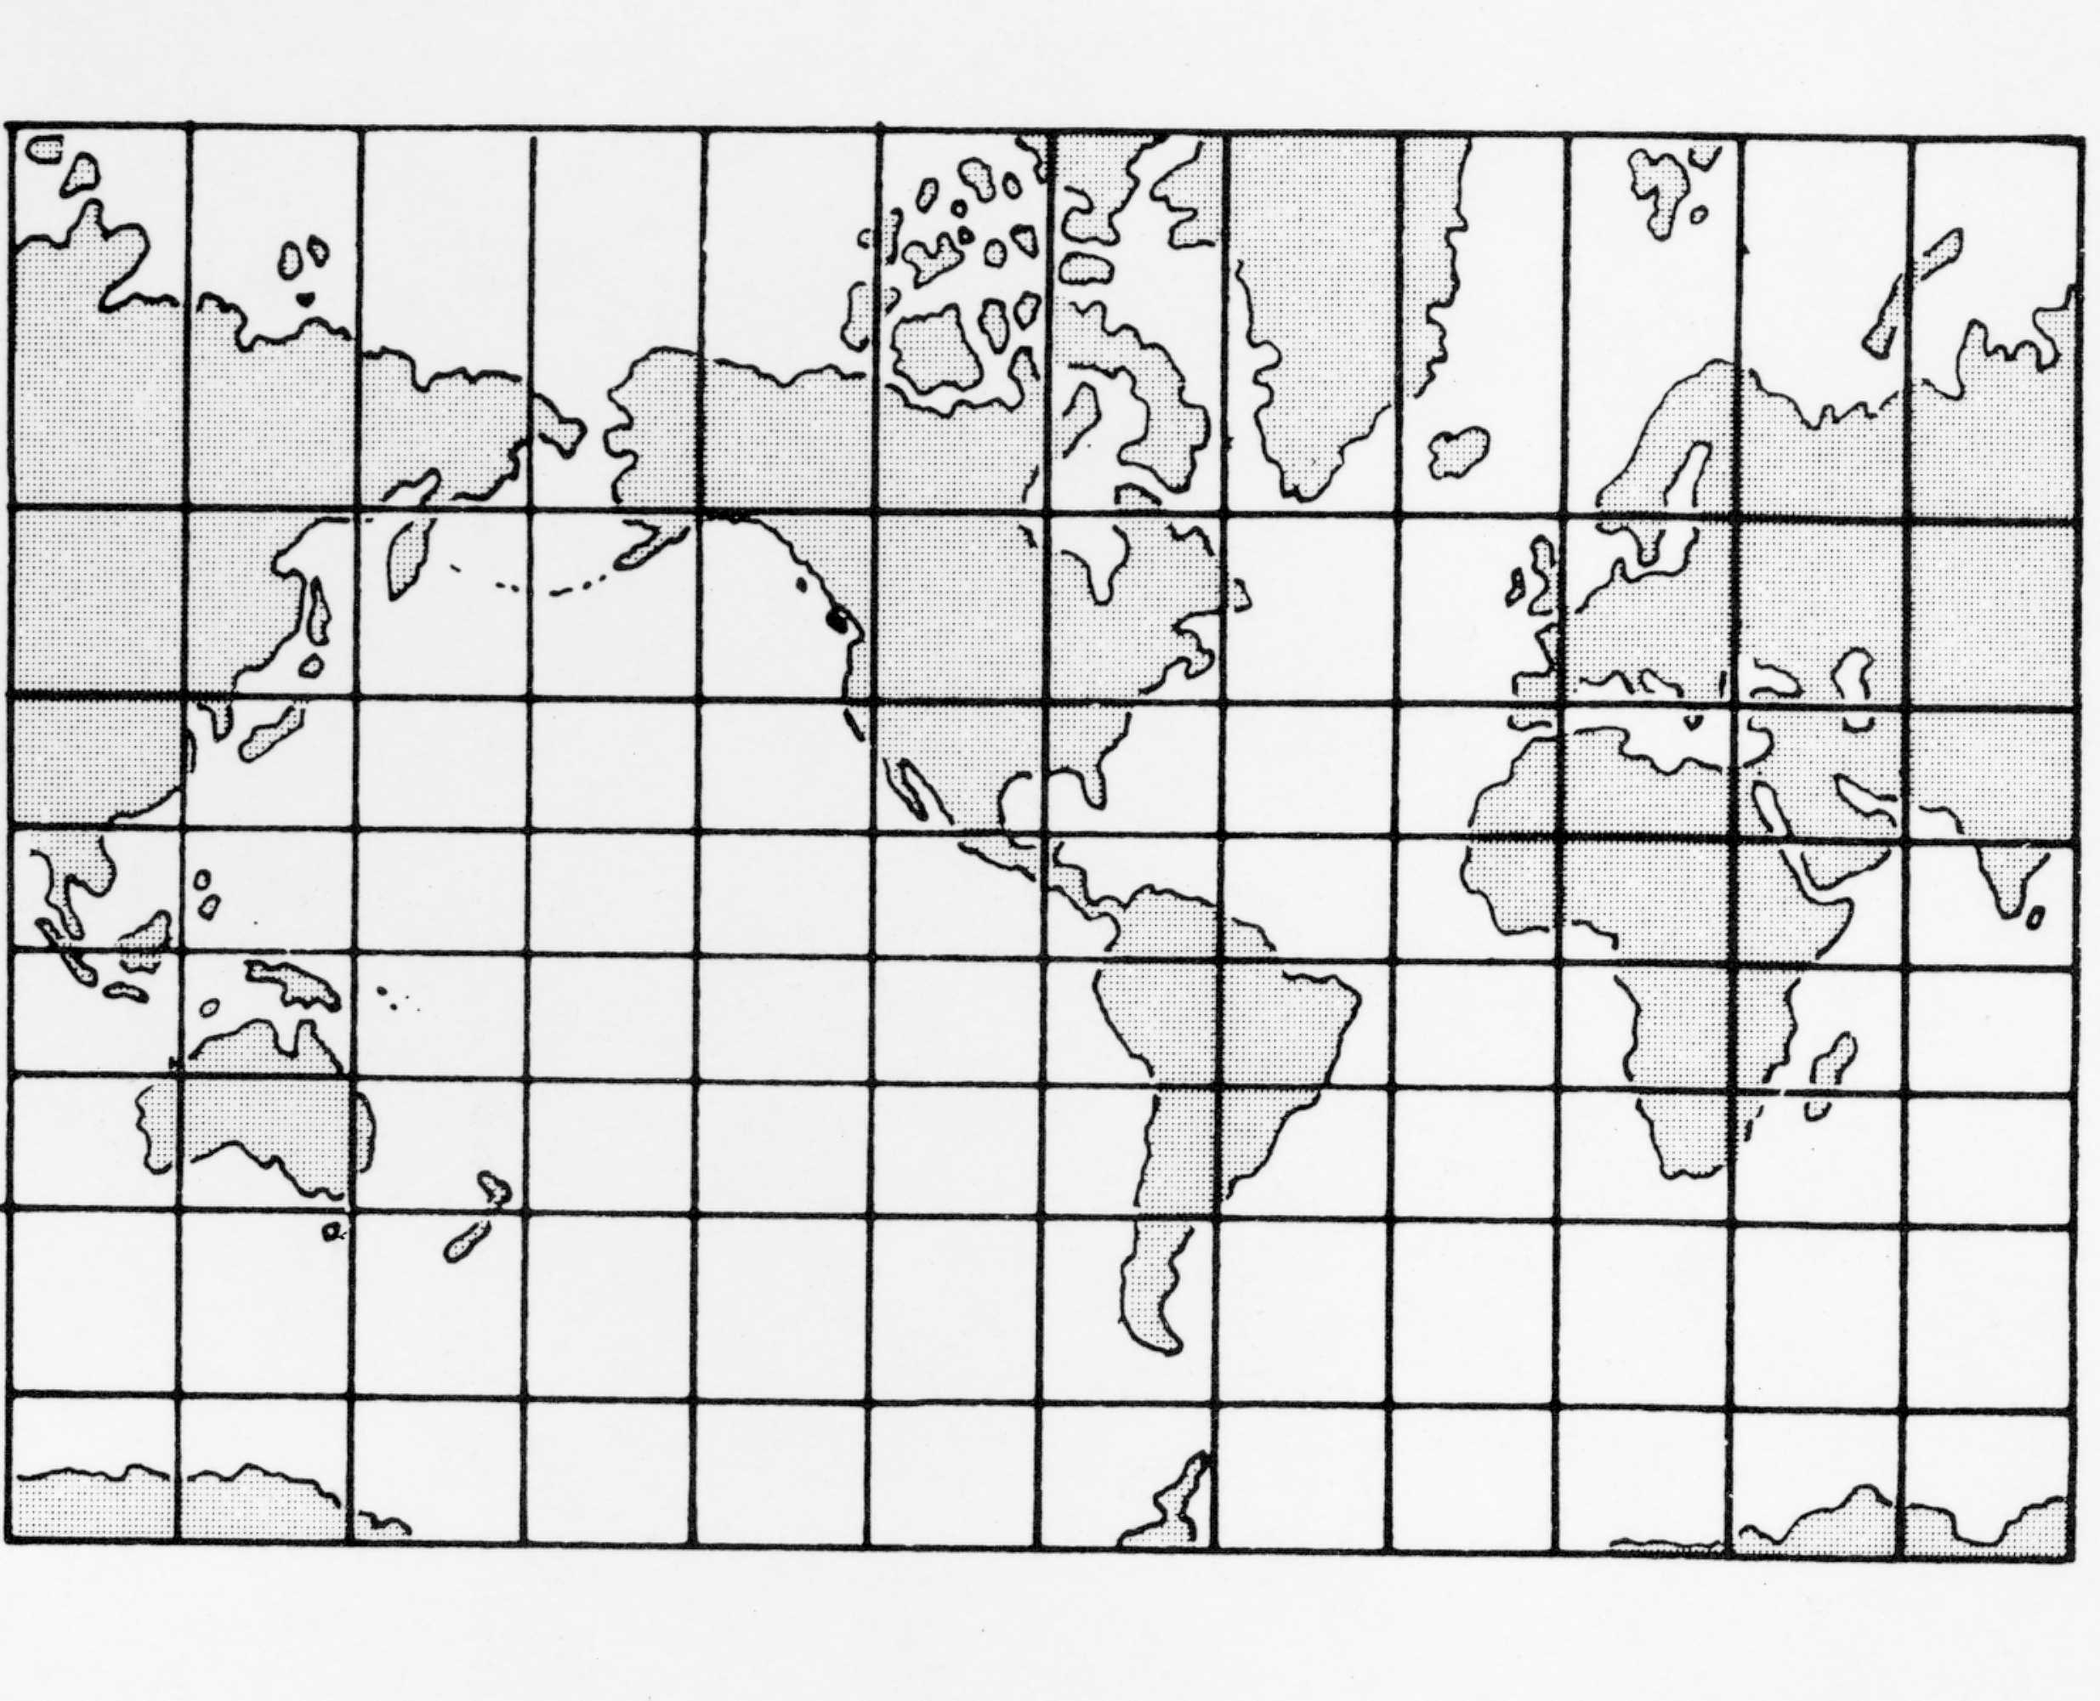
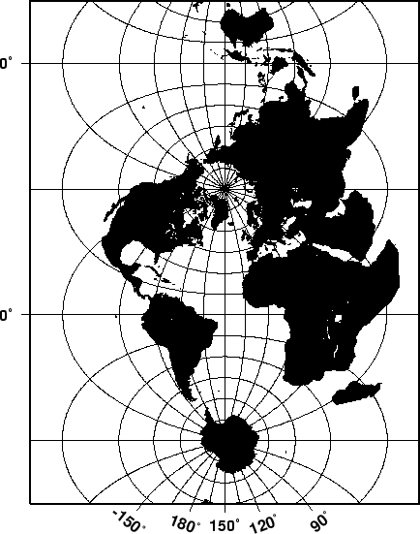
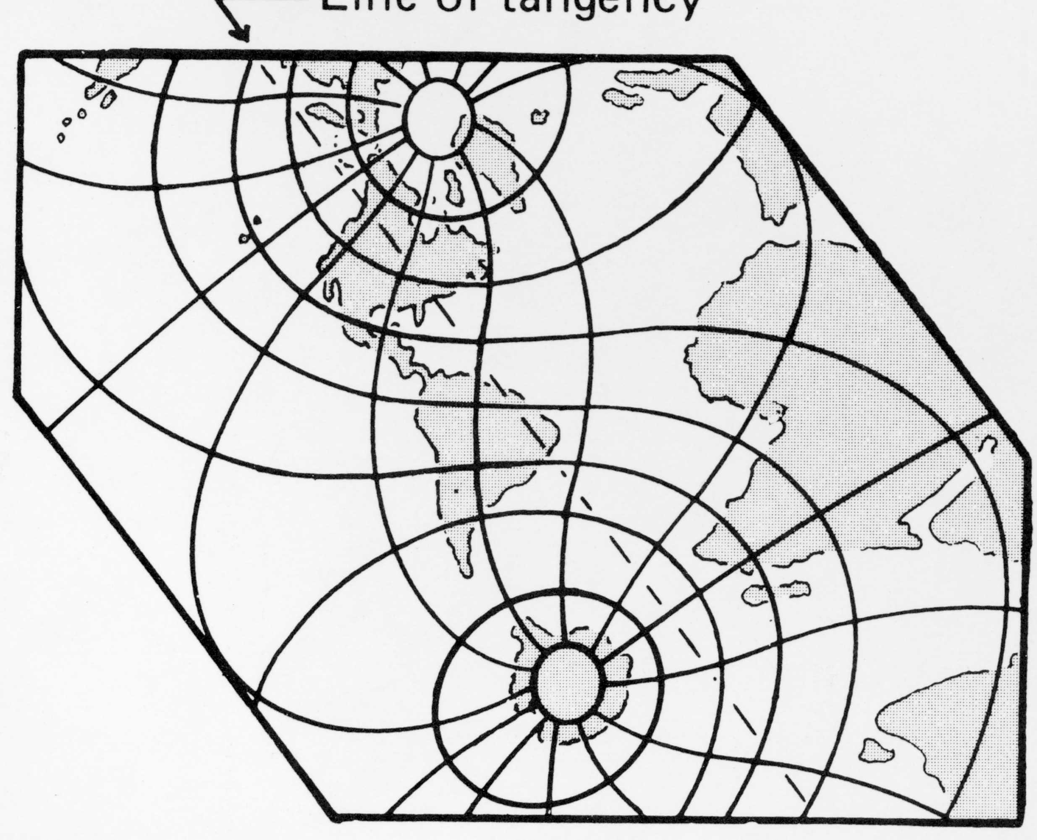
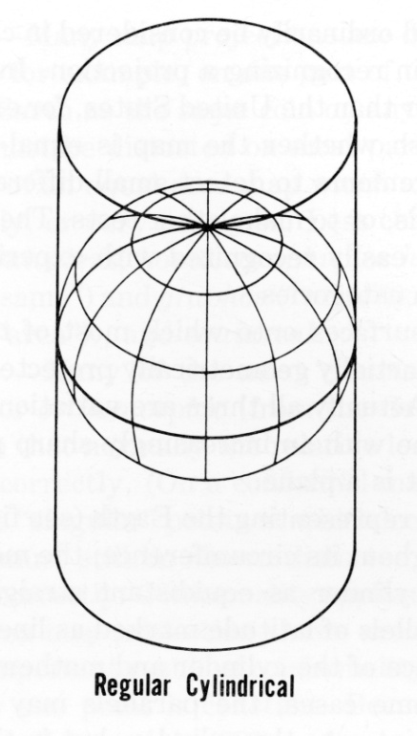
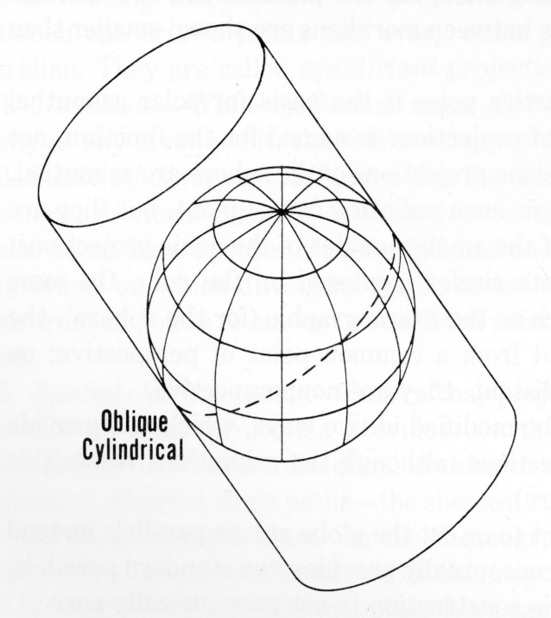
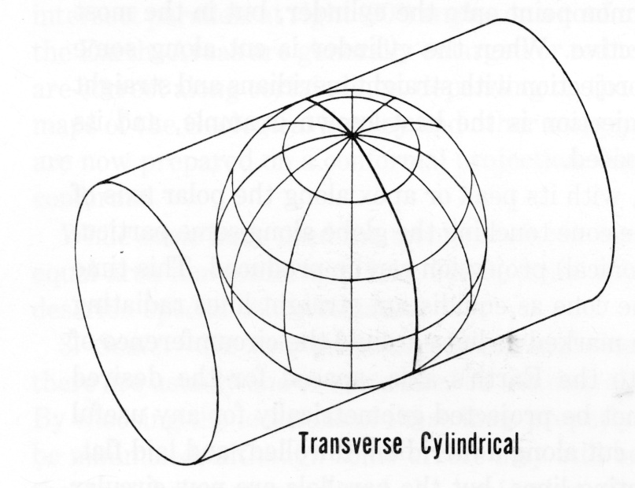
Cylindrical Projections
Regular
Transverse
Oblique

Slide 42
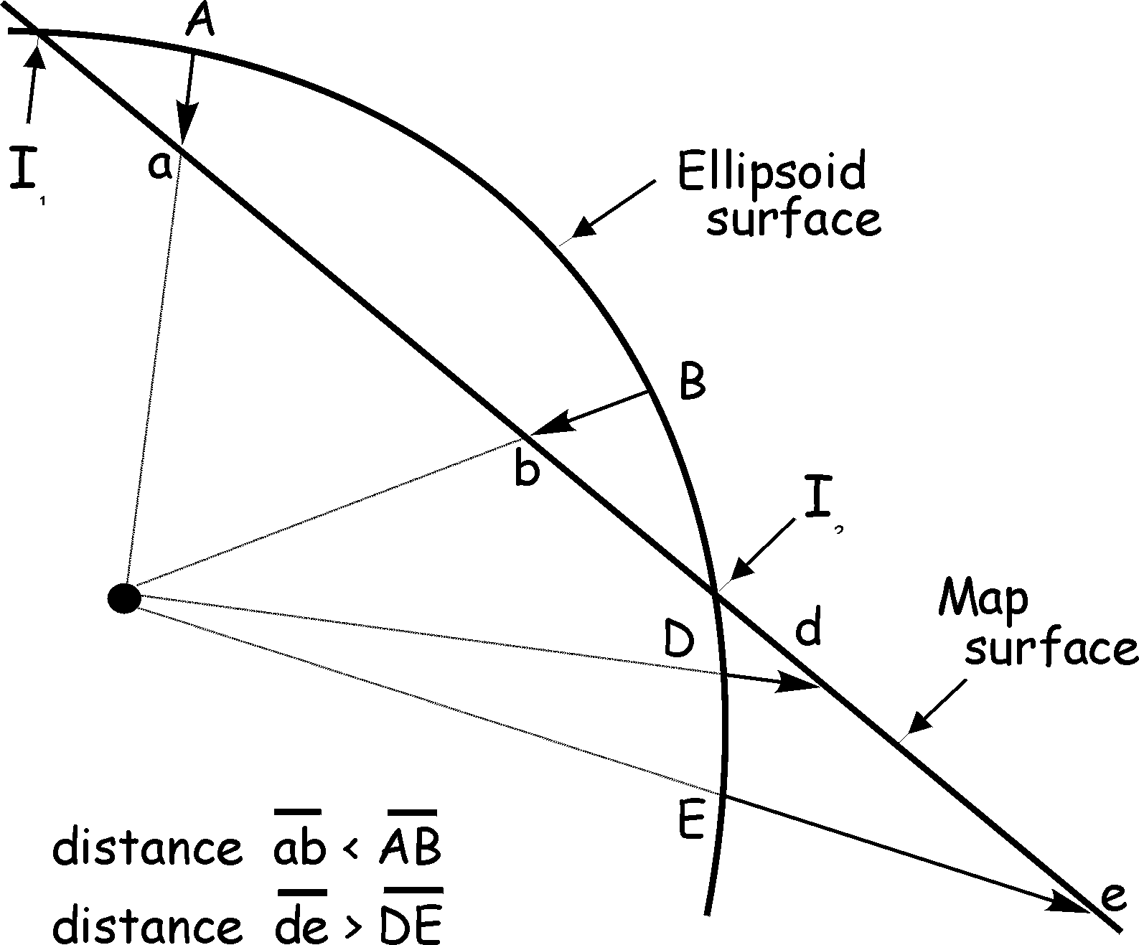
Distortion during Map Projection
I = intersection pts (aka
Standard Lines or Parallels)
A,B,D,E = map surface edge
a,b,d,e = scaled map surface
Bolstad, Fig. 3-16

Slide 43
Map Projection & Distortion
Converting a sphere to a flat surface results in distortion.
Shape (conformal) - If a map preserves shape, then feature outlines (like county boundaries) look the same on the map as they do on the earth.
Area (equal-area) - If a map preserves area, then the size of a feature on a map is the same relative to its size on the earth.
Distance (equidistant) - An equidistant map is one that preserves true scale for all straight lines passing through a single, specified point. If a line from a to b on a map is the same distance that it is on the earth, then the map line has true scale. No map has true scale everywhere.
Direction/Azimuth (azimuthal) – An azimuthal projection is one that preserves direction for all straight lines passing through a single, specified point.

Slide 44
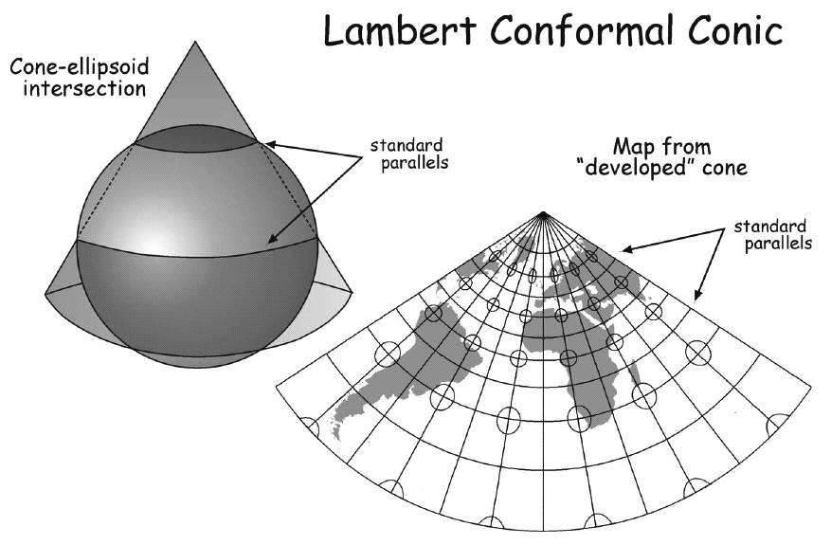
Common US/Florida Projections
Distortion least between standard parallels
Good for E–W extensive study areas
Conformal: Azim. angles measured locally are correct

Slide 45
Alerts Equal Area Conic
Areas proportional to those on earth
Distortion least between standard parallels
Good for E/W-extensive study areas
Best for mid-latitudes
Used by Florida Geographic Data Library, many agencies in Florida

Slide 46
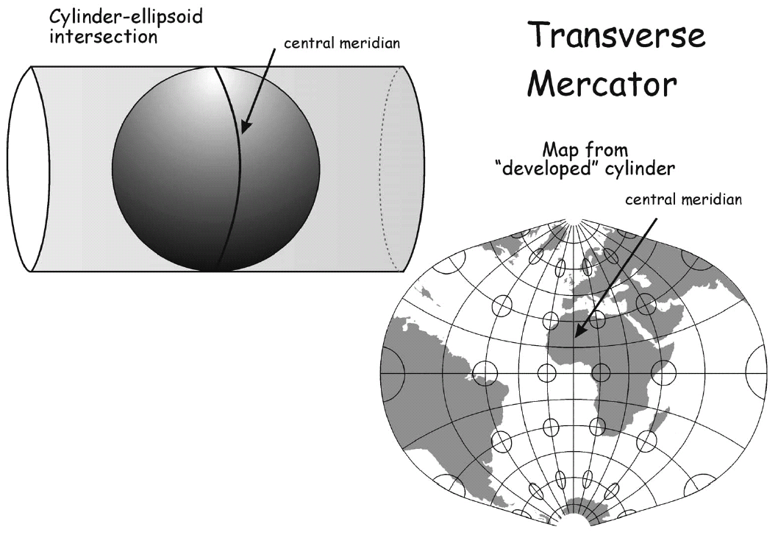
Common US/Florida Projections
Distortion least near central meridian
Good for N/S-extensive study areas
Conformal, so OK for navigation (like normal Mercator)

Slide 47
Universal Transverse Mercator Coordinate System
World divided into 60 six-degree-wide zones
Wide zones good for large study areas
But, coordinates discontinuous across zone boundaries
From 80S to 84N
Zones numbered 1-60 (N&S), W to E, starting at 180W
Excellent discussion in Bolstad (pp. 80-82): read!

Slide 48
UTM Grid Overlay
60 Zones, and 20 Latitude Bands
Zones
17
1
60
84º N
X
W
V
U
T
S
R
R
Q
P
17R
Latitude Bands
N
M
Equator
L
K
J
H
G
F
E
D
80º S
C
http://www.dmap.co.uk/utmworld.htm
Notes:
Universal Transverse Mercator
Note: The grid shown in the example is not drawn to scale.
There are sixty UTM zones, running north-south, cover all of the earth, beginning with zone 1 located at 180º W longitude. Twenty latitude bands, running east-west, cover most of the earth from 80º S latitude to 84º N latitude. The polar regions are covered by the Universal Polar Stereographic coordinate system, which is based on the UTM system. Notice that the letters “I” and “O” are not used to designate a latitude band. This is to prevent confusion with the numbers 1 and 0. The equator separates latitude bands N (north of the equator), and M (south of the equator). If a GPS receiver is showing a position with a latitude band letter of C through M, then it thinks it’s in the southern hemisphere. If the latitude band letter shown on a GPS receiver display is N through X then the receiver thinks it’s position is in the northern hemisphere. Either hemisphere could have exactly the same easting and northing coordinates representing two different locations (one in each hemisphere) within the same zone.
Zones and latitude bands make up 1,200 unique grid rectangles in the UTM grid system. A UTM zone is 6° wide (remember, it’s based on longitude) and extends from 80° south latitude to 84° north latitude. By knowing the correct zone number and latitude band letter, you can narrow your location from the entire surface of the earth down to a rectangle 6° x 8°, as shown in the example above with “21T.” The easting and northing numbers refine the position to a single point somewhere inside that rectangle.
Try this test with your GPS receiver. Set your receiver coordinate system to UTM. Get a UTM position where you live, and save it as a waypoint. Now change the coordinate system in the receiver to latitude and longitude (it doesn't matter which format you select). Then edit the waypoint in lat/long by changing just the longitude to a new value. For example, if the original waypoint longitude shows 115° 10' 30", change the degrees from 115° to 90°. Save the modified waypoint, and change the lat/long coordinate system back to UTM in the receiver's setup page. Now look at the saved waypoint once again in UTM. Notice how the UTM zone number has changed to match the edited longitude. Try the same test again, only this time leave the coordinates in UTM. Edit the northing coordinate by a large amount and notice how the latitude band changes automatically the moment you save the edited waypoint.

Slide 49
UTM Zones in the Contiguous U.S.
Longitude
126⁰
120⁰
114⁰
108⁰
102⁰
96⁰
90⁰
84⁰
78⁰
72⁰
66⁰
19
10
11
12
18
13
14
15
16
17
UTM Zones
Notes:
UTM Zones Covering the Contiguous U.S.
The continental United States lies within ten UTM zones. Zone boundaries are determined by longitude meridians six degrees apart.

Slide 50
UTM Zones - Side by Side
84⁰ N
6⁰
6⁰
6⁰
6⁰
6⁰
6⁰
Equator
80⁰ S
Notes:
UTM Zones - Side by Side
The 60 zones that make up the UTM coordinate system are independent of each other, and have no association with each other. The poles are covered by the Universal Polar Stereographic (UPS) coordinate system. In the northern hemisphere the UTM grid ends at 84º north latitude, and in the southern hemisphere it ends at 80º south latitude. At the equator each UTM zone is less than a million meters wide, so no UTM zone ever exceeds one million meters in width (hence only six digits are required in easting coordinate values). At 84º N latitude, each UTM zone is less than 200,000 meters wide. This is because the longitude lines that form UTM zones converge as they get closer to the poles.

Slide 51
State Plane Coordinate System
Underlying projections:
Lambert Conformal Conic for “east-west” areas
Transverse Mercator for “north-south” areas
Oblique Mercator for Alaska
Local FIPS (Federal Information Processing Standards) zone (name or number) must be specified in GIS (e.g., any of three in Florida) when projecting into state plane
Specify datum and units, too…
But no “projection parameters”
US only
Notes:
Federal Information Processing Standards
FIPS zones on many Web sites, often in GIS Help

Slide 52
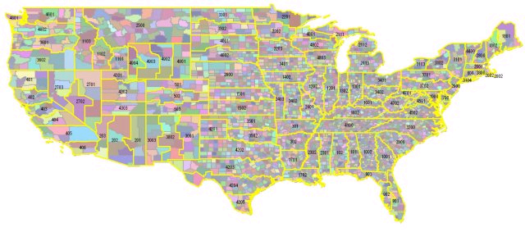
Map of SPC Systems
The solid yellow lines indicate zones

Slide 53
State Plane Coordinate System
Divides the US into 120 sections, referred to as zones. Each zone is assigned a code number that defines the projection parameters for the region.
Zones that lie north-south (New Jersey) use the Transverse Mercator projection; zones that lie east-west (Tennessee) use the Lambert Conformal Conic.
Developed in the 1930s by the US Coast and Geodetic Survey to provide a common references system for highway engineering, survey marker location, and other high-precision needs.
Goal was to design a conformal (preserve shapes) mapping system for the country with a maximum scale distortion of one part in 10,000, then considered the limit of surveying accuracy.
Four times more accurate than UTM.

Slide 54
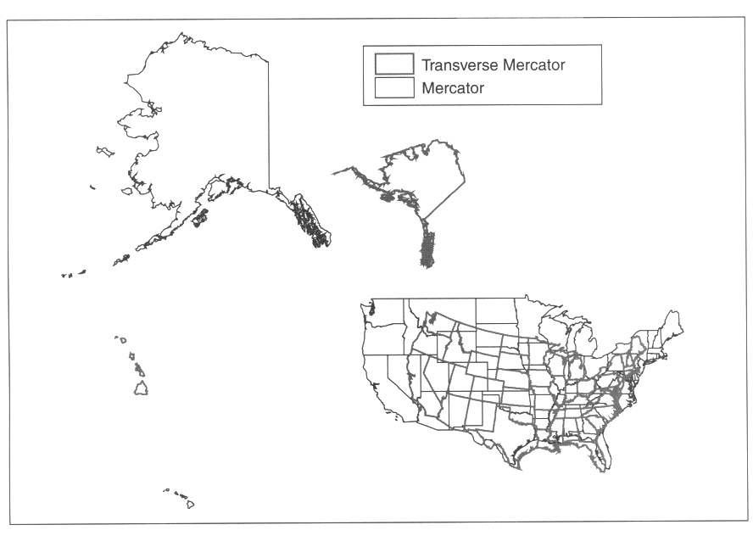
Different Projections

Slide 55
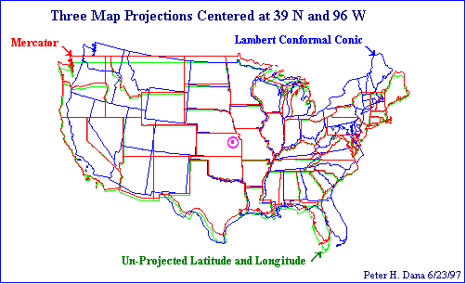
Differences between Projections

Slide 56
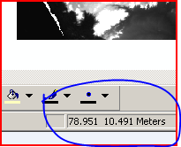
What is wrong in this map?

Slide 57
Working with Coordinate System in GIS
Projection in ArcGIS
Projection define
Select a predefined projection
Import from a file which has projection defined
Define by your own
Projection transform
On-the-fly Projection

